Slide 1


Hotel Reservation analysis
By : Mariam Hossam Goda
Batch number : MIP-DA-10

Slide 2
Overview
The hotel industry relies on data to make informed decisions and provide a better guest experience. In this internship, you will work with a hotel reservation dataset to gain insights into guest preferences, booking trends, and other key factors that impact the hotel's operations.

Slide 3
Dataset Details :
The dataset includes the following columns:
● Booking_ID: Unique identifier for each reservation.
● no_of_adults: Number of adults in the reservation.
● no_of_children: Number of children in the reservation.
● no_of_weekend_nights: Weekend nights in the reservation.
● no_of_week_nights: Weekday nights in the reservation.
● type_of_meal_plan: Chosen meal plan.
● room_type_reserved: Reserved room type.
● lead_time: Days between booking and arrival.
● arrival_date: Date of arrival.
● market_segment_type: Market segment of the reservation.
● avg_price_per_room: Average price per room.
● booking_status: Booking status

Slide 4
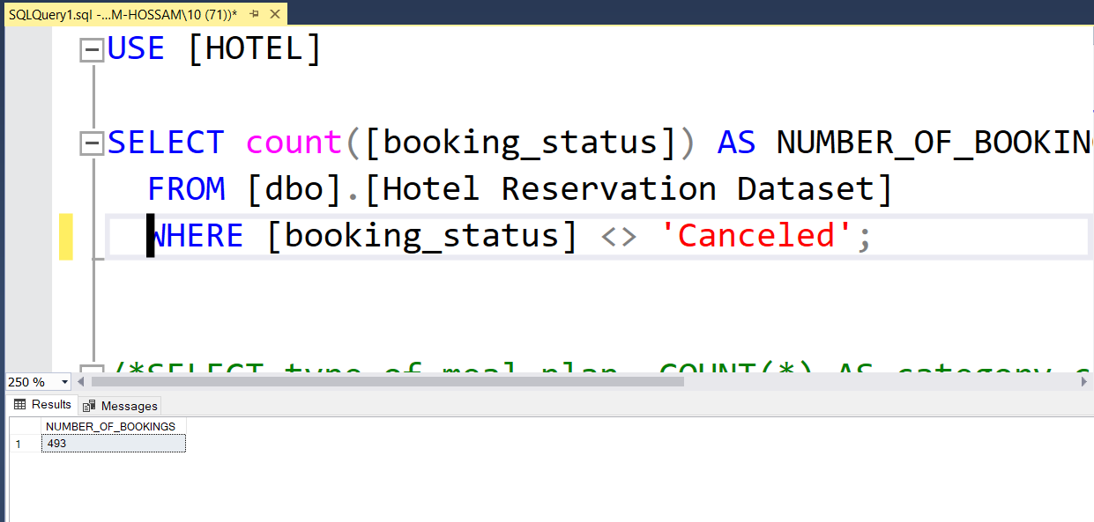

What is the total number of reservations in the dataset?

Slide 5
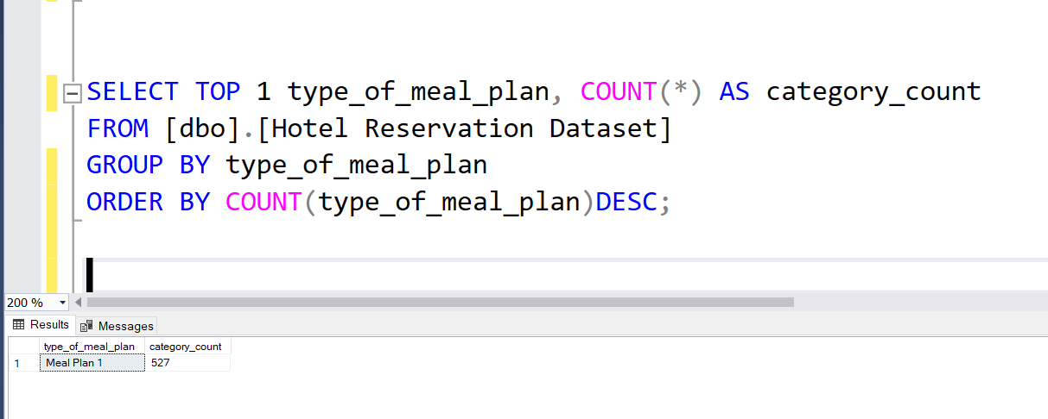

Which meal plan is the most popular among guests?

Slide 6
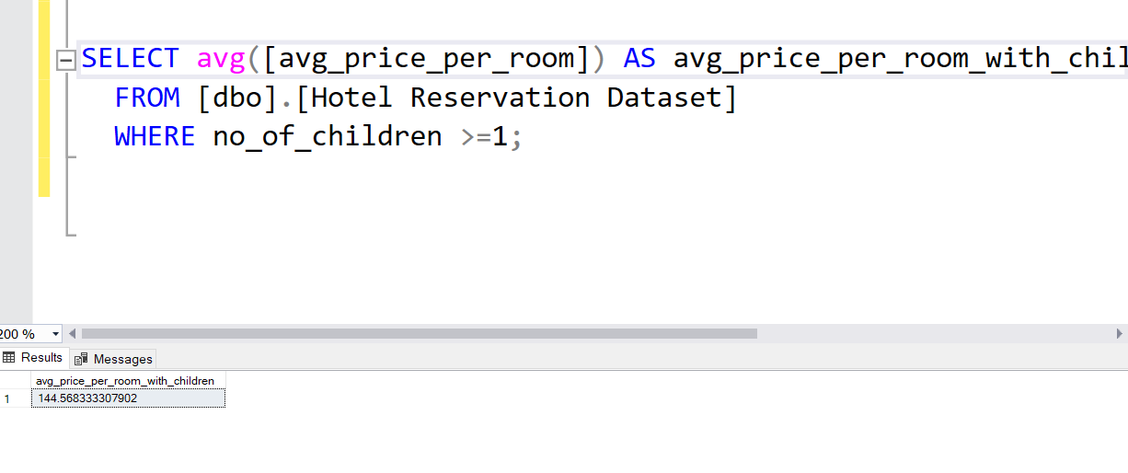

What is the average price per room for reservations involving children?.

Slide 7
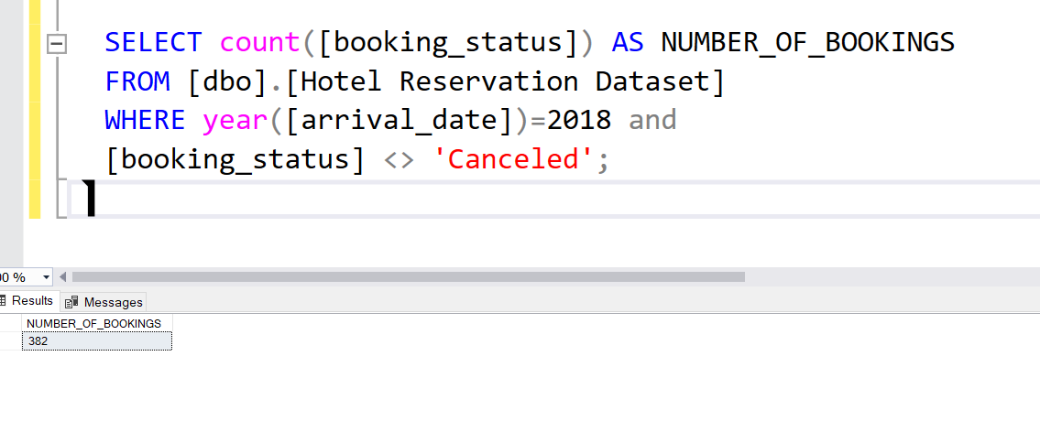

. How many reservations were made for the year 20XX (replace XX with the desired year)?

Slide 8
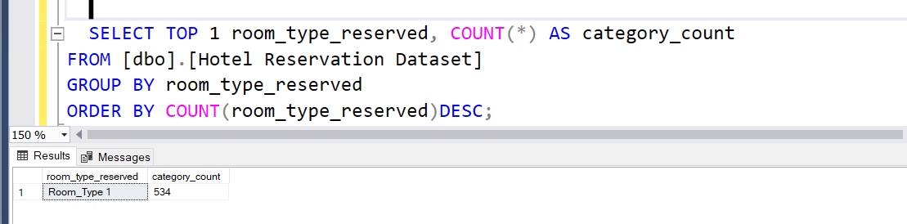

What is the most commonly booked room type?

Slide 9
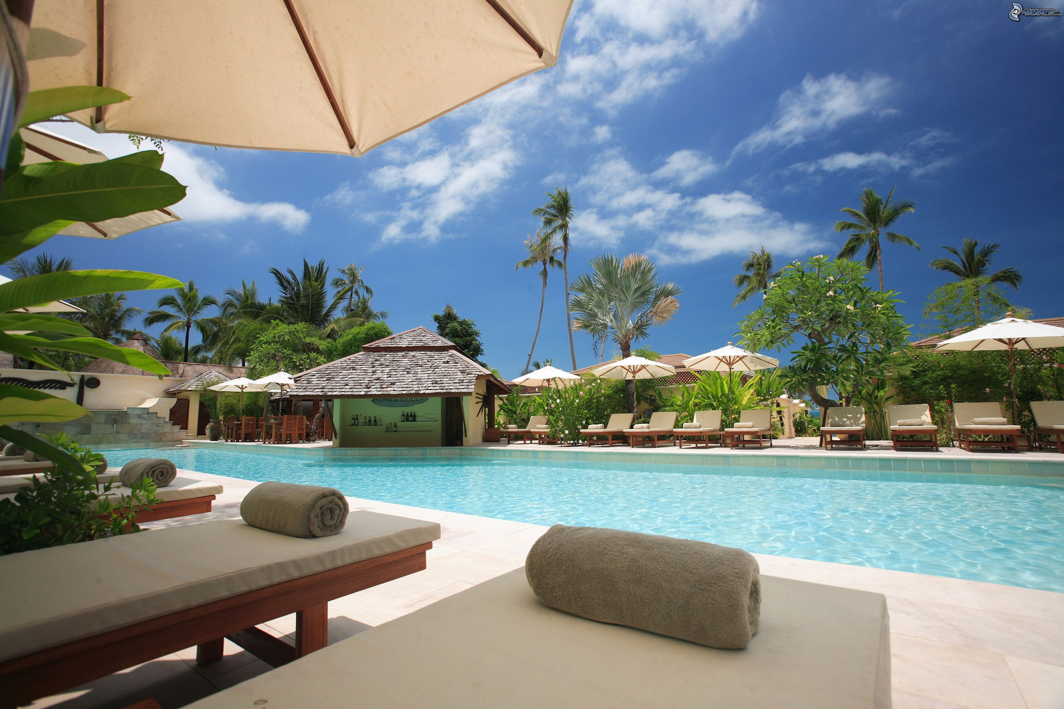
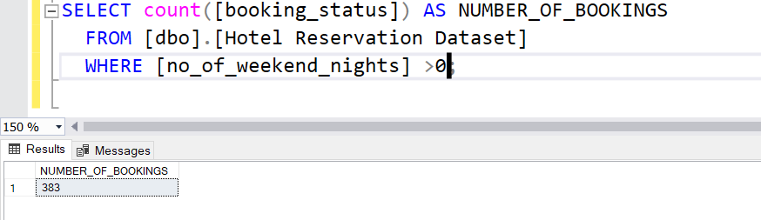

How many reservations fall on a weekend (no_of_weekend_nights > 0)?

Slide 10

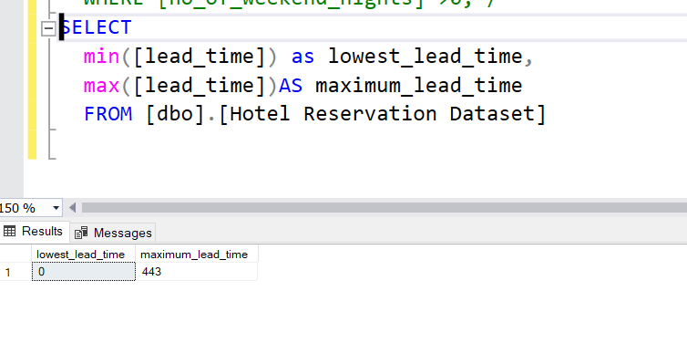

What is the highest and lowest lead time for reservations

Slide 11
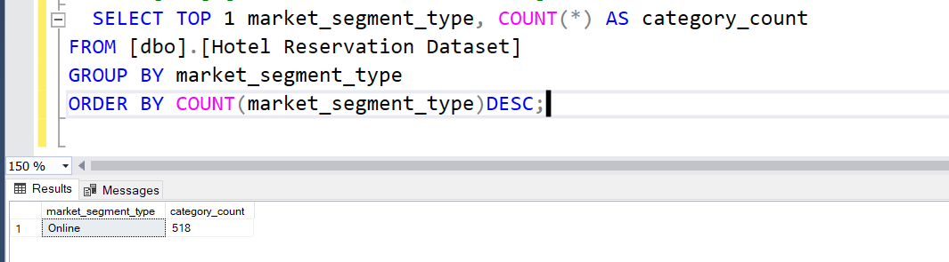

What is the most common market segment type for reservations

Slide 12
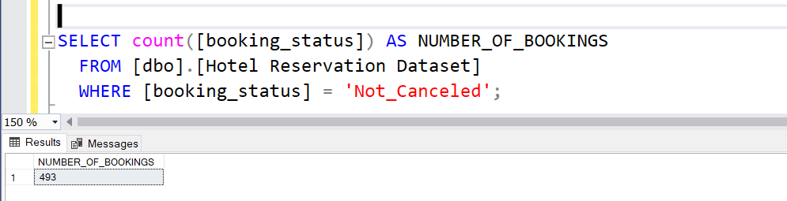
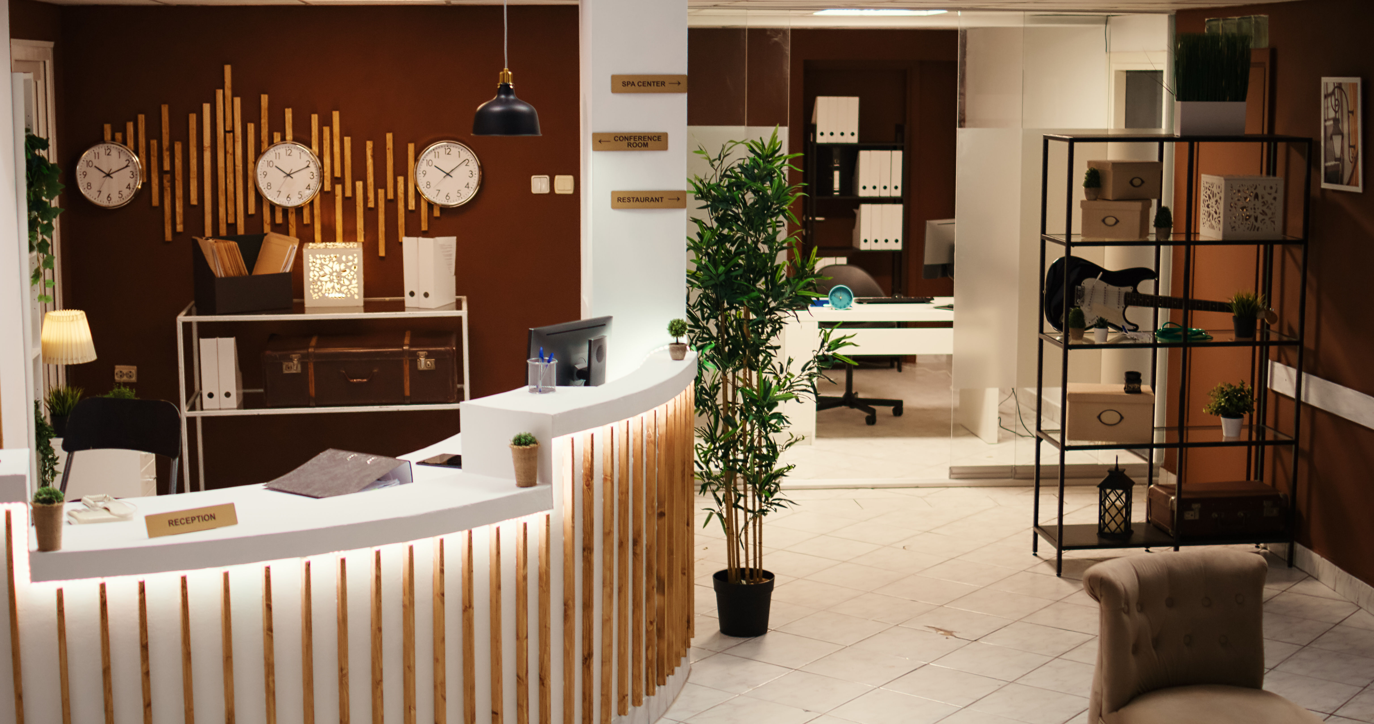

How many reservations have a booking status of "Confirmed"?

Slide 13
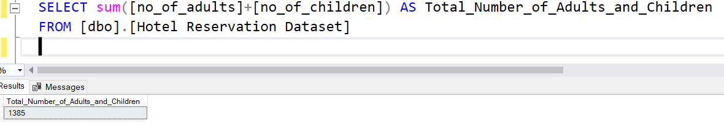

What is the total number of adults and children across all reservations

Slide 14
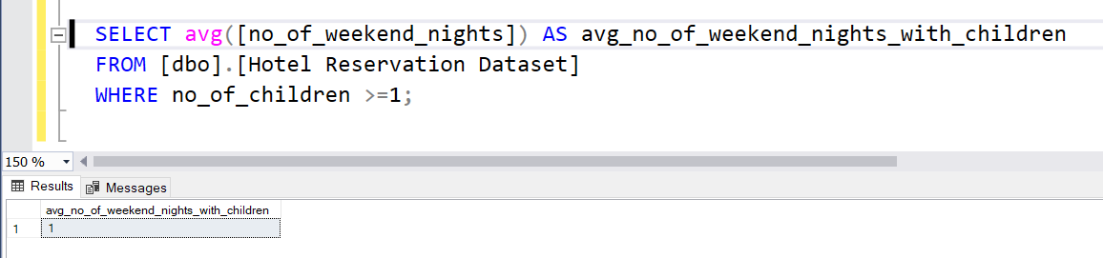

What is the average number of weekend nights for reservations involving children?

Slide 15
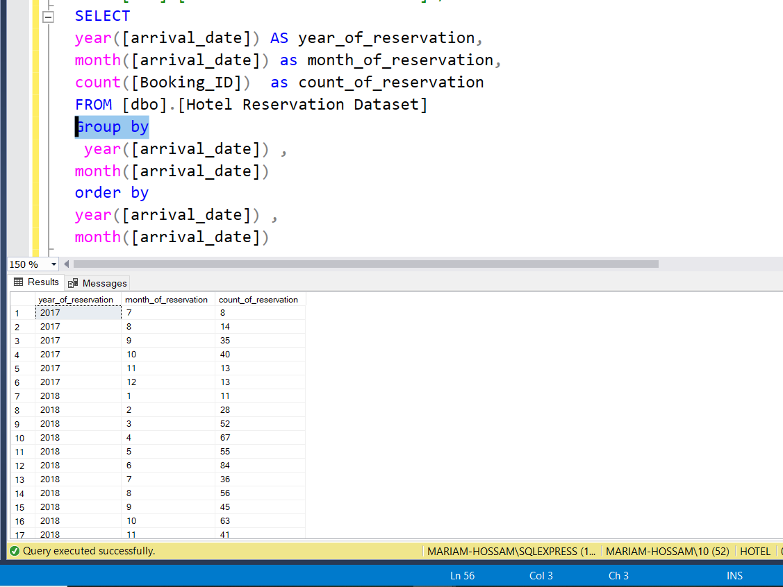

How many reservations were made in each month of the year?

Slide 16
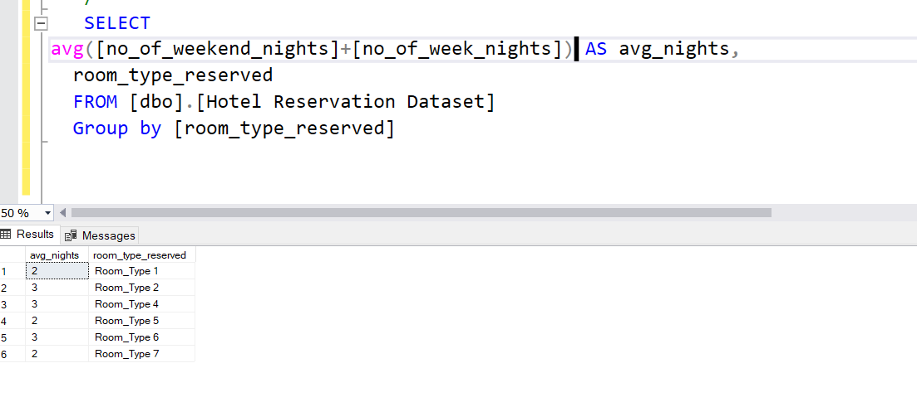

What is the average number of nights (both weekend and weekday) spent by guests for each room
type

Slide 17
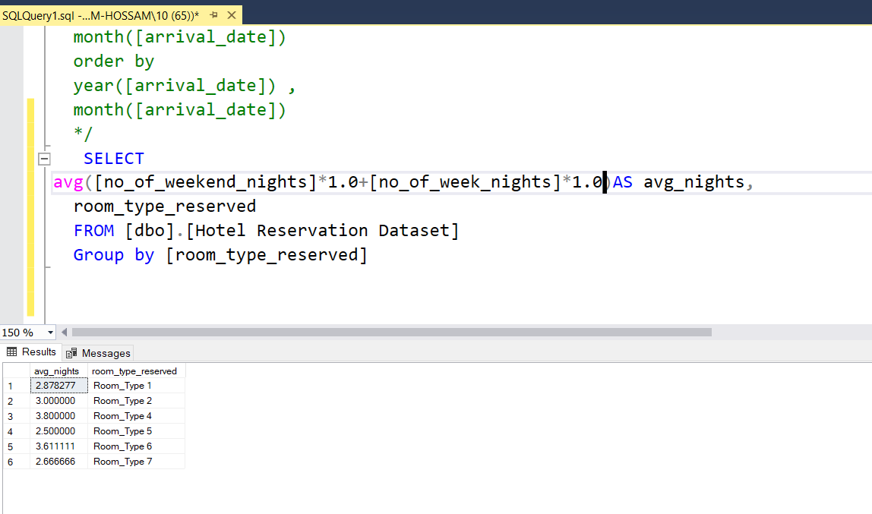

For reservations involving children, what is the most common room type, and what is the average price for that room type

Slide 18
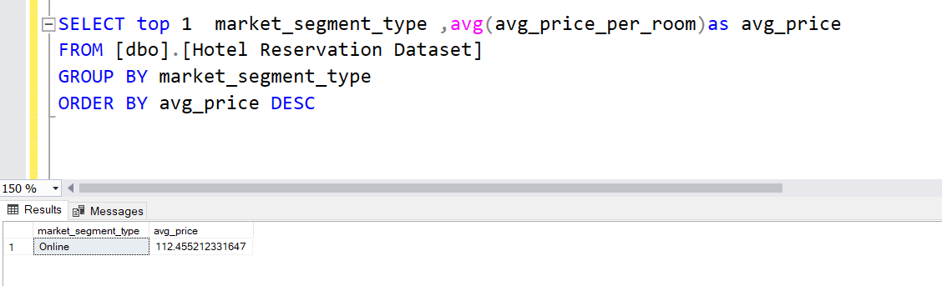

Find the market segment type that generates the highest average price per room.

Slide 19

Recommendations:
Increase Marketing Efforts During Peak Booking Periods
Offer Special Packages for Popular Room Types and Meal Plans
Implement Strategies to Reduce Cancellations
Focus on Attracting Corporate Bookings
Offers during week to increase reservation
Discount for long period reservation
Take a feedback of canceled reservations
Increase booking price in the season
special offers on online market segment

Slide 20

Conclusion
The analysis shows that certain meal plans and room types are very
popular, with weekends seeing a surge in bookings. Families prefer
specific room types and prices, while a key market segment books the
highest rates. By using these insights, the hotel can enhance its
offerings, target marketing efforts, and improve guest experiences,
leading to increased bookings and higher revenue

Slide 21

Thank you

